Slide 1
Chapter 6: Multiple Linear Regression
Data Mining for Business Analytics in R
(c) 2017 Shmueli, Bruce, Yahav & Patel
© Galit Shmueli and Peter Bruce 2017

Slide 2
Topics
Explanatory vs. predictive modeling with regression
Example: prices of Toyota Corollas
Fitting a predictive model
Assessing predictive accuracy
Selecting a subset of predictors
Additional topics
© Galit Shmueli and Peter Bruce 2017

Slide 3

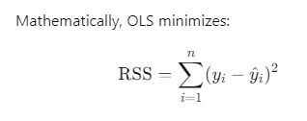
Multiple Linear Regression and Ordinary Least Squares (OLS) Method
outcome
coefficients
constant
error (noise)
predictors
© Galit Shmueli and Peter Bruce 2017
Notes:
Most often Linear Regression implies Linear Regression with OLS.
Ordinary Least Squares method to estimate the coefficients.
RSS = Residual Sum of Squares. aka, Sum of Squared Residuals (SSR) or Error Sum of Squares (SSE).
Linear Regression can be solved using other methods:
Ridge Regression (L2 Regularization)
Lasso Regression (L1 Regularization)
Elastic Net Regression (combination of L1 and L2 Regularization)
Principal Component Regression (PCR)
Partial Least Squares (PLS)
Least Absolute Deviations (LAD) Regression
Bayesian Linear Regression

Slide 4
Explanatory Modeling
Goal: Explain relationship between predictors (explanatory variables) and target
Familiar use of regression in data analysis
Model Goal: Fit the data well and understand the contribution of explanatory variables to the model
“goodness-of-fit”: R², residual analysis, p-values
© Galit Shmueli and Peter Bruce 2017
Notes:
Explanatory Modeling can be thought of as Descriptive and Diagnostic analytics. After which come predictive and then prescriptive.
To summarize the main differences in using a linear regression in the two scenarios:
1. A good explanatory model is one that fits the data closely, whereas a good predictive model is one that predicts new records accurately. Choices of input variables and their form can therefore differ.
2. In explanatory models, the entire dataset is used for estimating the best fit model, to maximize the amount of information that we have about the hypothesized relationship in the population. When the goal is to predict outcomes of new individual records, the data are typically split into a training set and a validation set. The training set is used to estimate the model, and the validation or holdout set is used to assess this model’s predictive performance on new, unobserved data.
3. Performance measures for explanatory models measure how close the data fit the model (how well the model approximates the data) and how strong the average relationship is, whereas in predictive models performance is measured by predictive accuracy (how well the model predicts new individual records).
4. In explanatory models the focus is on the coefficients (B), whereas in predictive models the focus is on the predictions (^y).

Slide 5
Predictive Modeling
Goal: predict target values in other data where we have predictor values, but not target values
Classic data mining context
Model Goal: Optimize predictive accuracy
Train model on training data
Assess performance on validation (hold-out) data
Explaining role of predictors is not primary purpose (but useful)
© Galit Shmueli and Peter Bruce 2017
Notes:
The core assumption behind linear regression is that there is a linear relationship between the predictor variables and the outcome variable. Violating this assumption may lead to biased or inefficient estimates, affecting both model interpretation and predictive accuracy.
Individual Linearity: Each predictor should ideally show a linear relationship with the outcome when other predictors are held constant.
Collective Linearity: The weighted sum of all predictors should have a linear relationship with the outcome.
Both interpretations are useful, and the choice between them often depends on the objective of your analysis. If you're interested in understanding the effect of each individual predictor, you may focus on individual linearity. If you're more concerned with prediction, collective linearity might be sufficient.
Note that transformations, interactions, and polynomial terms can be introduced to handle non-linearities effectively within a "linear" regression framework. These techniques allow the model to capture complex relationships while still maintaining the core structure of a linear model.

Slide 6
Explanatory vs. Predictive Modeling
 | Explanatory Modeling | Predictive Modeling
Objective | Understand and quantify the average effect of predictors on an outcome. | Predict the outcome value for new records.
Focus | Focus on coefficients (interpretation of relationships). | Focus on predictions (y^\hat{y}y^​, accuracy of forecast).
Dataset Usage | Uses the entire dataset to estimate the best-fit model. | Splits the dataset into training and validation sets.
Performance Measure | Measures how well the model fits the data (how closely it approximates relationships). | Measures predictive accuracy on new records.
Variable Selection | Choose variables that best explain the relationships in the data. | Choose variables that give the best predictive power for unseen data.
Model Fitting | Tends to fit the data closely to understand relationships. | Tries to generalize to unseen data by finding a balance between fitting and avoiding overfitting.
Use Case Example | "A unit increase in service speed improves customer satisfaction by 5 points." | Predicting the satisfaction score for a new customer based on historical data.

Slide 7
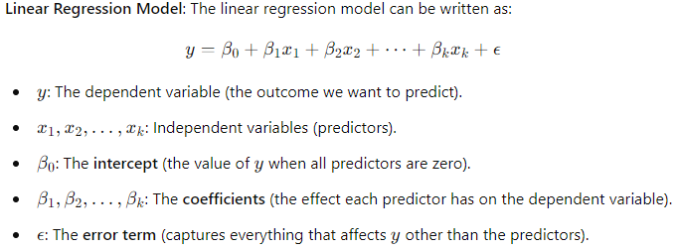
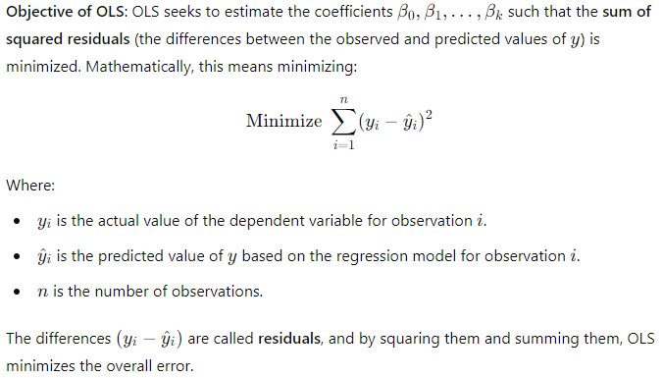
OLS
Notes:
Ordinary Least Squares method to estimate the coefficients.
RSS = Residual Sum of Squares. aka, Sum of Squared Residuals (SSR) or Error Sum of Squares (SSE).
Why Minimize the Sum of Squared Residuals (RSS)?
OLS chooses to minimize the sum of squared residuals (instead of, for example, the absolute residuals or the residuals themselves) for a few reasons:
Mathematical Simplicity: Squaring the residuals results in a smooth function that is differentiable, making it easier to apply calculus to find the minimum value.
Outlier Sensitivity: Squaring the residuals gives more weight to larger errors, which means OLS is sensitive to outliers. This can be a drawback, but it can also help the model fit the bulk of the data more closely.
Unbiasedness: Under the assumptions of OLS (such as linearity, homoscedasticity, and no perfect multicollinearity), OLS provides unbiased estimates of the coefficients.
Assumptions for OLS: OLS is based on several key assumptions:
Linearity: The relationship between the dependent and independent variables is linear.
Independence: The observations are independent of each other.
Homoscedasticity: The residuals have constant variance (i.e., the spread of residuals is the same across all levels of the independent variables).
Normality of Errors: For valid hypothesis testing and inference, the errors should follow a normal distribution (though this is not necessary for the OLS estimates themselves to be unbiased).
No Multicollinearity: The independent variables should not be too highly correlated with each other.

Slide 8
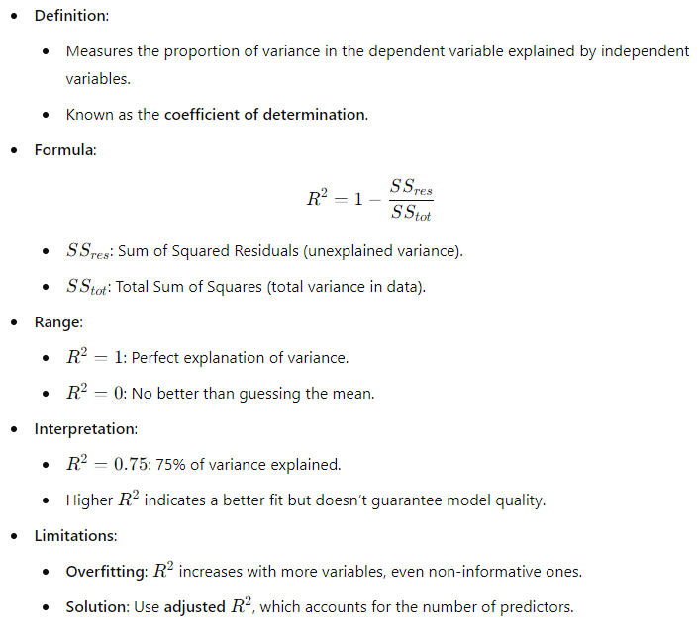
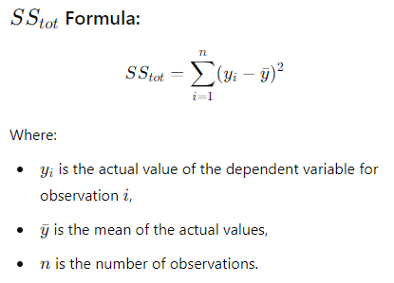
R²

Slide 9
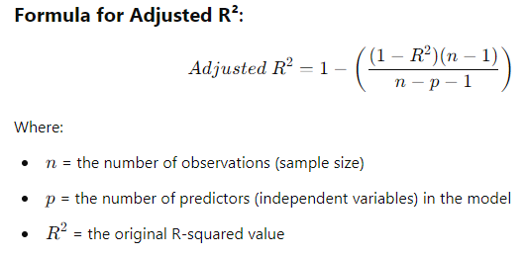
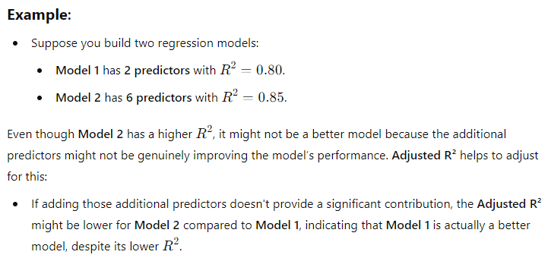
Adjusted R²
Adjusted for number of predictors
More appropriate when comparing models with different number of predictors

Slide 10
Residual Analysis
Residual Analysis helps assess whether the assumptions of linear regression hold
Linearity: The relationship between predictors and the outcome is linear
Homoscedasticity: The variance of the residuals is constant across all levels of the independent variables
Independence: The residuals are independent of each other
Normality: The residuals are normally distributed
Notes:
Obtain Residuals and Fitted Values:
The residuals are the difference between the actual values and the predicted (fitted) values. The fitted values are the predictions from the model.
Check the Linearity Assumption:
Plot Residuals vs. Fitted Values:
The relationship between the predictors and the outcome should be linear. This can be checked by plotting the residuals against the fitted values.
What to look for: The residuals should be randomly scattered around zero. A non-random pattern (e.g., curvature) suggests that the linearity assumption is violated.
Check the Homoscedasticity Assumption:
Plot Residuals vs. Fitted Values (again):
Homoscedasticity means that the variance of the residuals is constant across all levels of the predictors. In other words, the spread of residuals should be roughly the same across fitted values.
What to look for: A consistent "cloud" of residuals. If the residuals fan out or contract, it indicates heteroscedasticity (non-constant variance).
A funnel-shaped plot suggests that the variance of the residuals increases with fitted values, violating the homoscedasticity assumption. In such cases, transforming the dependent variable (e.g., using a log transformation) or using a heteroscedasticity-consistent standard error estimator may help.
Check the Independence Assumption:
Durbin-Watson Test:
Independence means that the residuals should not be autocorrelated. This is particularly important for time series data, where the residuals from one observation might affect the next.
The Durbin-Watson test can check for autocorrelation in the residuals.
A test statistic close to 2 suggests no autocorrelation. A value significantly below 2 indicates positive autocorrelation, while a value significantly above 2 suggests negative autocorrelation.
Check the Normality Assumption:
Normal Q-Q Plot:
Residuals are assumed to follow a normal distribution. A Q-Q (quantile-quantile) plot helps assess this assumption by comparing the distribution of the residuals to a theoretical normal distribution.
What to look for: In a Q-Q plot, residuals should lie approximately along the 45-degree line.
If the residuals deviate significantly from the line, it suggests that the errors are not normally distributed. This may indicate that transformations of the data are needed.
Histogram of Residuals:
A histogram can also be used to visually inspect the distribution of residuals.

Slide 11
Example: Prices of Toyota Corolla ToyotaCorolla.xls
Goal: predict prices of used Toyota Corollas based on their specification
Data: Prices of 1442 used Toyota Corollas, with their specification information
© Galit Shmueli and Peter Bruce 2017

Slide 12
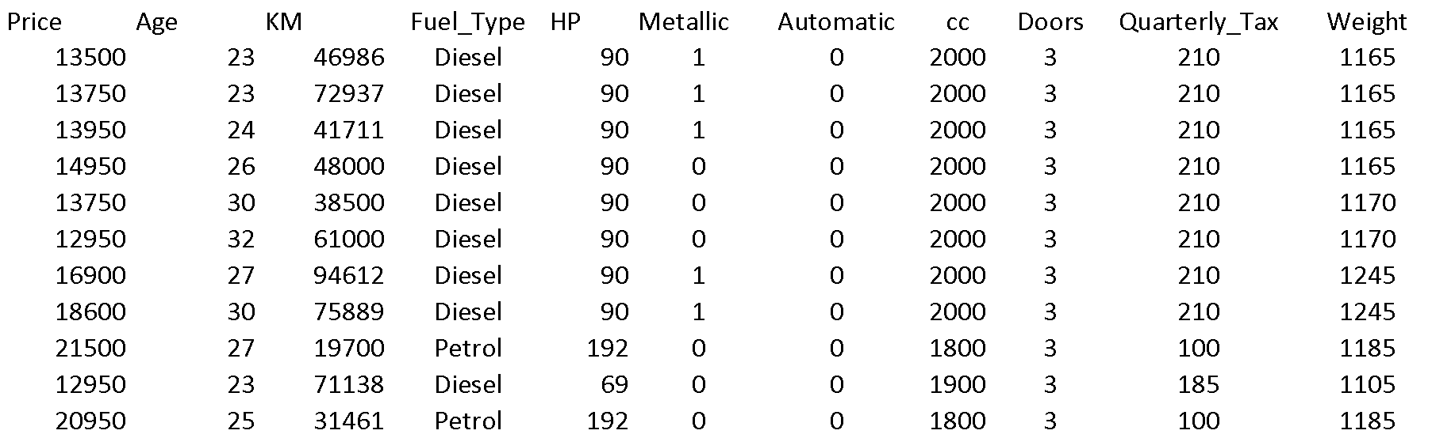
Data Sample (showing only the variables to be used in analysis)
© Galit Shmueli and Peter Bruce 2017

Slide 13
Variables Used
Price in Euros
Age in months as of 8/04
KM (kilometers)
Fuel Type (diesel, petrol, CNG)
HP (horsepower)
Metallic color (1=yes, 0=no)
Automatic transmission (1=yes, 0=no)
CC (cylinder volume)
Doors
Quarterly_Tax (road tax)
Weight (in kg)
© Galit Shmueli and Peter Bruce 2017

Slide 14
Preprocessing
Fuel type is categorical (in R - a factor variable), must be transformed into binary variables. R’s lm function does this automatically.
Diesel (1=yes, 0=no)
Petrol (1=yes, 0=no)
None needed* for “CNG” (if diesel and petrol are both 0, the car must be CNG)
*You cannot include all the binary dummies; in regression this will cause a multicollinearity error. Other data mining methods can use all the dummies.
© Galit Shmueli and Peter Bruce 2017

Slide 15
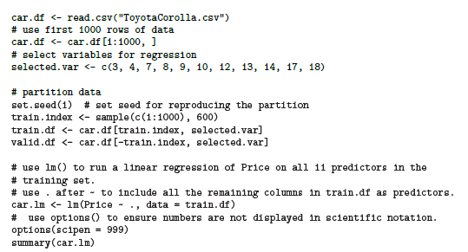
Fitting a Regression Model to the Toyota Data
put 60% in training
correction: 10
© Galit Shmueli and Peter Bruce 2017

Slide 16
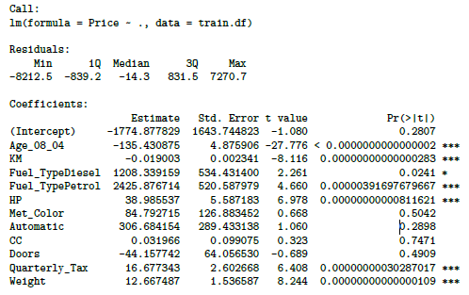
Output of the Regression Model
© Galit Shmueli and Peter Bruce 2017
Notes:
In a simple linear regression model, the equation is given by: Y=β0​+β1​X+ϵ
Here, β0​ is the intercept, β1​ is the slope, X is the independent variable, and ϵ is the random error term.
Few closely related concepts in statistical inference, particularly when assessing the significance of predictors in a regression model…

Slide 17
Accuracy Metrics for the Regression Model
Residual standard error: 1406 on 588
degrees of freedom
Multiple R-squared: 0.8567
Adjusted R-squared: 0.854
F-statistic: 319.6 on 11 and 588 DF
p-value: < 0.00000000000000022
These are traditional metrics, i.e. measured on the training data
© Galit Shmueli and Peter Bruce 2017

Slide 18
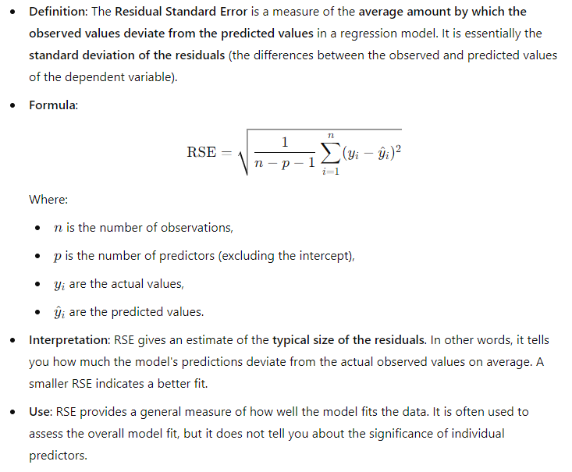
Residual Standard Error

Slide 19
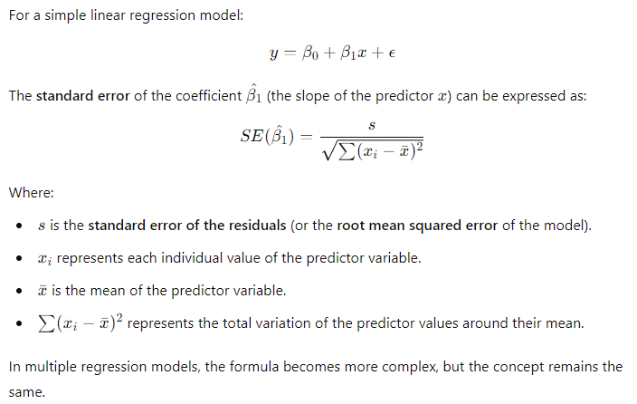
Standard Error of the Coefficient

Slide 20
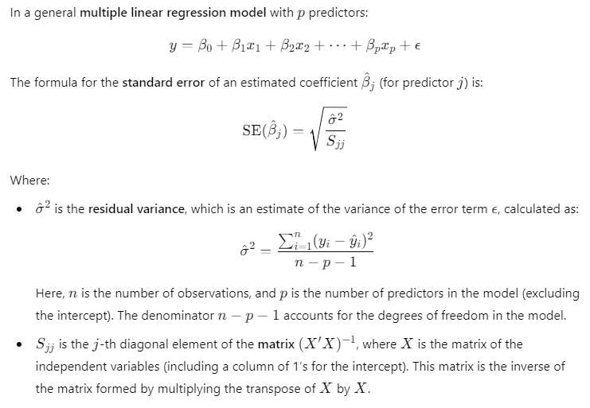
Standard Error of the Coefficient

Slide 21
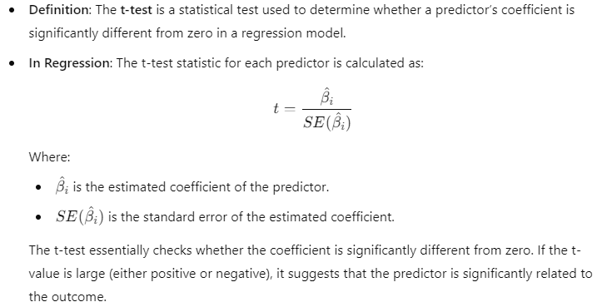
t-value
Notes:
A test statistic is a generic term for the calculated value used to decide whether to reject the null hypothesis in a hypothesis test. It measures how far your sample statistic (like the estimated regression coefficient) is from the null hypothesis value (like 0) relative to the variability of the data. Different tests have different kinds of test statistics depending on the situation, such as:
t-statistic (or t-value) (used in regression and t-tests),
F-statistic (used in ANOVA or tests of model fit),
z-statistic (used in z-tests, typically when sample sizes are large).

Slide 22
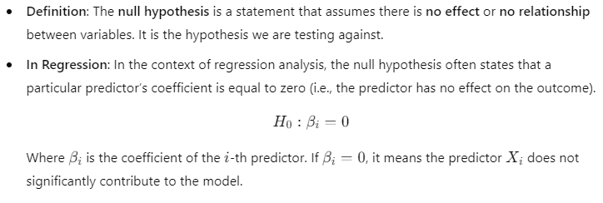
Null Hypothesis

Slide 23
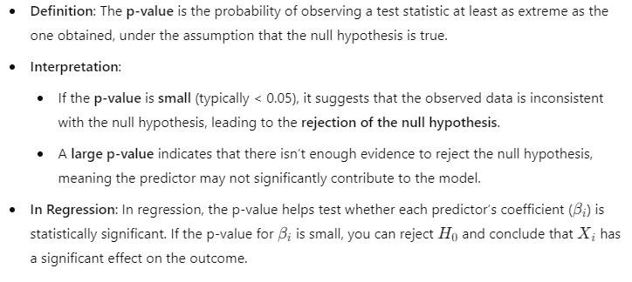
p-value
The p-value answers the question: If the null hypothesis is true (i.e., the coefficient is 0), what is the probability of observing a test statistic (like a t-statistic) as extreme or more extreme than the one obtained?
Notes:
Steps to calculate p-value from t-value
Calculate the t-Value
Determine the Degrees of Freedom
The degrees of freedom (df) in a regression model are important for calculating the p-value. They are calculated as:
df=n−k−1
Where:
n is the number of observations (data points).
k is the number of predictors (independent variables).
3. Find the p-Value Using the t-Distribution.

Slide 24
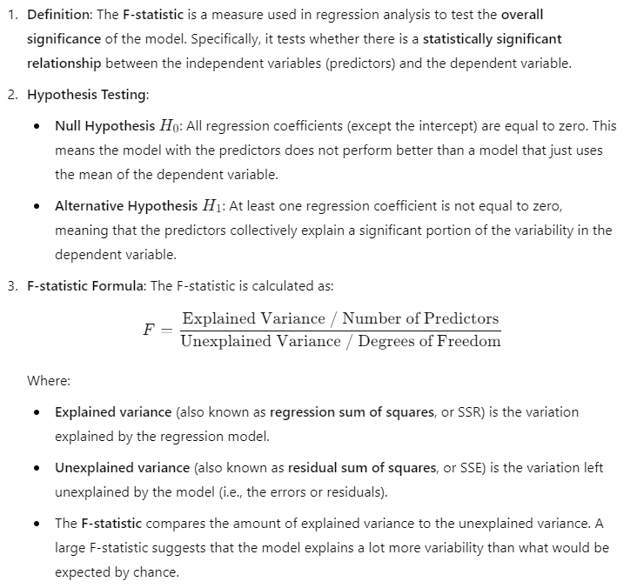
F-Statistic
Notes:
Sum of Squares due to Regression (SSR): The explained variability, which is the sum of the squared differences between the predicted values from the model and the mean of the actual observed.
F-Statistic can range from 0 to infinity.
The F-statistic is always positive because it is the ratio of two variances, and variances cannot be negative.
A small F-statistic (close to 1 or less) suggests that the model does not explain much more variability than would be expected by random chance.
A large F-statistic suggests that the model explains significantly more variability than would be expected by random chance.
How to Interpret the F-Statistic in General:
F-Statistic near 1:
If the F-statistic is near 1, it suggests that the model is not better than a simple model that uses the mean of the dependent variable to predict outcomes. The predictors do not seem to add much explanatory power.
F-Statistic significantly greater than 1:
If the F-statistic is significantly greater than 1, it suggests that the predictors in the model are explaining a significant amount of the variability in the dependent variable. The model is likely to be useful for prediction or explanation.

Slide 25
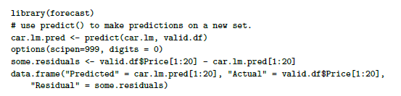
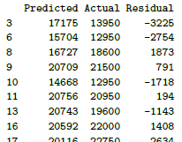
Make the Predictions for the Validation Data
(and show some residuals)
© Galit Shmueli and Peter Bruce 2017

Slide 26
How Well did the Model Do With the Validation Data?
# use accuracy() to compute common accuracy measures.
accuracy(car.lm.pred, valid.df$Price)
ME = mean error
RMSE = root mean squared error
(sq. root of mean squared error)
MAE = mean absolute error
MPE = mean percent error
MAPE = mean absolute percent error
accuracy(car.lm.pred, valid.df$Price)
ME RMSE MAE MPE MAPE
Test set -40.1 1321 1012 -1.72 9.01
“test set” means the data that lm analyzed, not “test set” in the data mining sense
© Galit Shmueli and Peter Bruce 2017

Slide 27
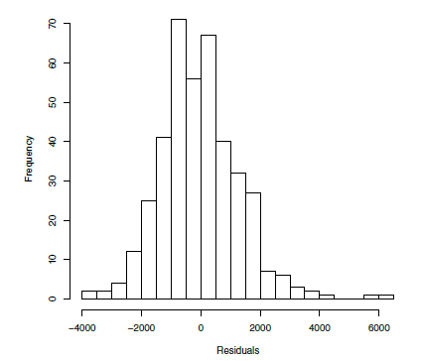
Distribution of Residuals
Symmetric distribution
A few outliers
© Galit Shmueli and Peter Bruce 2017
Notes:
In general, lower errors like a lower Root Mean Square Error (RMSE) or Mean Squared Error (MSE) suggest that the model fits the data better and therefore is a better model. However, this principle has several important caveats:
Overfitting
A model that perfectly fits your data (i.e., RMSE = 0 or very close to 0) may simply be memorizing the data rather than generalizing from it. Such a model is said to be "overfit," and it will likely perform poorly on new, unseen data.
Complexity vs Simplicity
A more complex model may have lower errors but may not necessarily be "better" if a simpler model performs nearly as well. Criteria like the Akaike Information Criterion (AIC) or the Bayesian Information Criterion (BIC) can help in model selection by balancing fit and complexity.
Domain Knowledge
Understanding of the subject matter can be crucial. Sometimes a higher-error model might be preferable if it is easier to interpret or if its predictions align better with theoretical expectations.
Model Purpose
The "best" model depends on what you are using it for. If interpretability is key, you may be willing to sacrifice some predictive power. On the other hand, if you are solely interested in making accurate predictions, a complex "black-box" model may be appropriate.
Validation
Performance should be assessed not just on the training data but also on a separate validation or test set to evaluate the model's generalization capability. Cross-validation is a commonly used technique for this purpose.
Comparative Metrics
Sometimes it's useful to use relative measures of error like the Mean Absolute Percentage Error (MAPE) or to compare the RMSE against a baseline model (like a random or naïve model) to understand how much better your model is compared to a simple prediction.
Residual Analysis
Lower errors should be accompanied by a good residual plot. The residuals should be random, normally distributed, and homoscedastic (i.e., have constant variance) for the model to be considered good.
Multiple Metrics
It's often wise to look at multiple performance metrics to get a well-rounded view of the model's performance.
So, while lower errors like RMSE are generally a good sign, they should be only one part of a comprehensive evaluation strategy for a predictive model.

Slide 28
Variable Selection in Linear Regression
Notes:
Given the high speed of modern algorithms for multiple linear regression calculations, it is tempting in such a situation to take a kitchen-sink approach: Why bother to select a subset? Just use all the variables in the model.
• It may be expensive or not feasible to collect a full complement of predictors for future predictions.
• We may be able to measure fewer predictors more accurately (e.g., in surveys).
• The more predictors, the higher the chance of missing values in the data. If we delete or impute records with missing values, multiple predictors
will lead to a higher rate of record deletion or imputation.
• Parsimony is an important property of good models. We obtain more insight into the influence of predictors in models with few parameters.
• Estimates of regression coefficients are likely to be unstable, due to multicollinearity in models with many variables. (Multicollinearity is the presence
of two or more predictors sharing the same linear relationship with the outcome variable.) Regression coefficients are more stable for parsimonious
models. One very rough rule of thumb is to have a number of records n larger than 5(p + 2), where p is the number of predictors. • It can be shown that using predictors that are uncorrelated with the outcome variable increases the variance of predictions.
• It can be shown that dropping predictors that are actually correlated with the outcome variable can increase the average error (bias) of predictions.
The last two points mean that there is a trade-off between too few and too many predictors. In general, accepting some bias can reduce the variance in predictions. This bias–variance trade-off is particularly important for large numbers of predictors, because in that case, it is very likely that there are variables in the model that have small coefficients relative to the standard deviation of the noise and also exhibit at least moderate correlation with other variables. Dropping such variables will improve the predictions, as it reduces the prediction variance. This type of bias–variance trade-off is a basic aspect of most data mining procedures for prediction and classification. In light of this, methods for reducing the number of predictors p to a smaller set are often used.

Slide 29
Selecting Subsets of Predictors
Goal: Find parsimonious model (the simplest model that performs sufficiently well)
More robust
Higher predictive accuracy
We will assess predictive accuracy on validation data
Exhaustive Search = “best subset”
Partial Search Algorithms
Forward
Backward
Stepwise
© Galit Shmueli and Peter Bruce 2017
Notes:
Step 1: The first step in trying to reduce the number of predictors should always be to use domain knowledge.
Step 2: The next step makes use of computational power and statistical performance metrics.
2.a The first is an exhaustive search for the “best” subset of predictors by fitting regression models with all the possible combinations of predictors. The exhaustive search approach is not practical in many applications, and implementation in R can be tedious and unstable.
2.b The second approach is to search through a partial set of models.

Slide 30
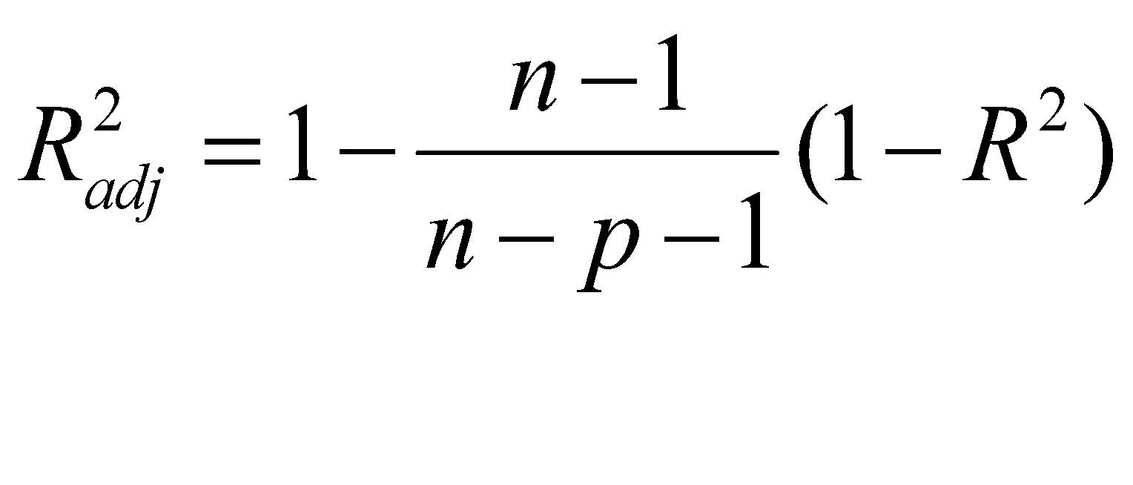
Exhaustive Search = Best Subset
All possible subsets of predictors assessed (single, pairs, triplets, etc.)
Computationally intensive, not feasible for big data
Judge by “adjusted R²”
Use regsubsets() in package leaps
Penalty for number of predictors
© Galit Shmueli and Peter Bruce 2017
Notes:
Combinations: 2^n
For 20 predictors, 1,050,000 combinations. Over a million.
2^11 is 2048

Slide 31
Exhaustive search requires library leaps and manual coding into binary dummies
library(leaps)
Fuel_Type <- as.data.frame(model.matrix(~ 0 + Fuel_Type, data=train.df))
train.df <- cbind(train.df[,-4], Fuel_Type[,])
head(train.df)
search <- regsubsets(Price ~ ., data = train.df, nbest = 1, nvmax = dim(train.df)[2], method = “exhaustive”)
sum <- summary(search)
sum$which
sum$rsq
sum$adjr2
sum$Cp
show models
show metrics
© Galit Shmueli and Peter Bruce 2017
Notes:
regsubsets() in leaps generates dummy variables.
The regsubsets() function in the leaps package in R is specifically designed for subset selection in multiple linear regression. It helps you identify which predictors (or combinations of predictors) are most effective for predicting the dependent variable.
The function performs "best subset selection" by evaluating all possible combinations of predictors to find the best model according to certain criteria like R^2, Adjusted R^2, AIC, BIC, or Mallows' Cp. By examining these statistics, you can choose the model that provides the best fit while balancing complexity and predictive power.
Mallows' Cp helps assess model fit and potential overfitting. A good model should have a Cp value close to the number of predictors + 1.

Slide 32
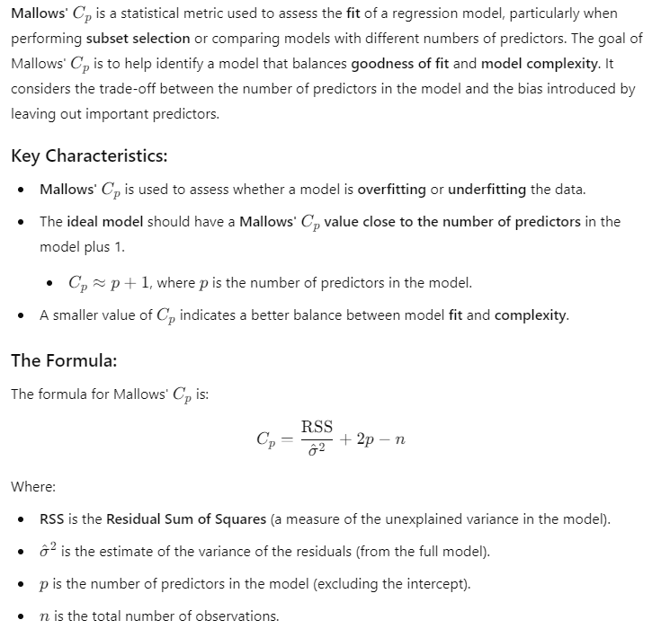
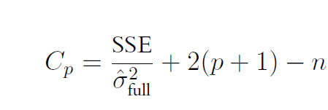
Mallow’s Cp

Slide 33
Adjusted R² for the models with 1 predictor, 2 predictors, 3 predictors, etc. (exhaustive search method)
> sum$adjr2
[1] 0.7556359 0.7922356 0.8267935 0.8436895 0.8494282 0.8534911
[7] 0.8544782 0.8545430 0.8543943 0.8542602 0.8540382
Adjusted R² rises until you hit 7-8 predictors, then stabilizes, so choose model with 7 predictors, according to the adj R² criterion
© Galit Shmueli and Peter Bruce 2017
Notes:
Higher the R Squared, the better the model is.
Same for Adjusted R Squared.
A lower value of Mallows’ Cp is generally considered better when you are comparing multiple models. The Cp statistic is used for model selection, aiming to find a model that provides a good fit while also being parsimonious (i.e., not overly complex).
Criteria for a Good Cp
Close to Number of Predictors: A Cp value close to the number of predictors P in the model (including the intercept) suggests that the model is relatively well-fitted.
Smallest Value: When comparing multiple models, the one with the smallest Cp value is generally considered the best, given that it should provide the most precise unbiased estimate of future performance.
Interpretation
A Cp much greater than P suggests that the model is overfitting, capturing noise rather than the underlying trend in the data.
A Cp much less than P could suggest that the model is underfitting and not capturing the underlying structure of the data.

Slide 34
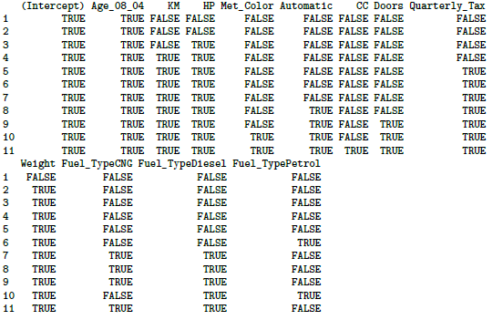
Exhaustive output shows best model for each number of predictors
Note: there are 12 instead of 10 predictors because with leaps we explicitly create dummy variables as part of the dataframe, this is handled internally by lm.
© Galit Shmueli and Peter Bruce 2017

Slide 35
Forward Selection
Start with no predictors
Add them one by one (add the one with largest contribution)
Stop when the addition is not statistically significant
use step() to run stepwise regression (available in lm).
set direction = forward
Specify the initial model (here, model with no predictors), and the bottom of the search range (here with no predictors) and the top (here with all predictors)
© Galit Shmueli and Peter Bruce 2017
Notes:
A lower AIC value is generally considered better when comparing multiple models. The goal in model selection is to minimize the AIC value. A lower AIC suggests a model that has a good balance between fit and complexity, which means it's likely to generalize better to new data.
Regarding the output at each step: The AIC values next to the predictors not included in the model indicate what the AIC would be if you added that predictor to the current model.

Slide 36
# create model with no predictors for bottom of search range
car.lm.null <- lm(Price~1, data = train.df)
# use step() to run forward selection
car.lm.step <- step(car.lm.null,
scope=list(lower=car.lm.null, upper=car.lm), direction =
"forward")
summary(car.lm.step)
# Which variables were added?
initial model
bounds of search range
© Galit Shmueli and Peter Bruce 2017

Slide 37
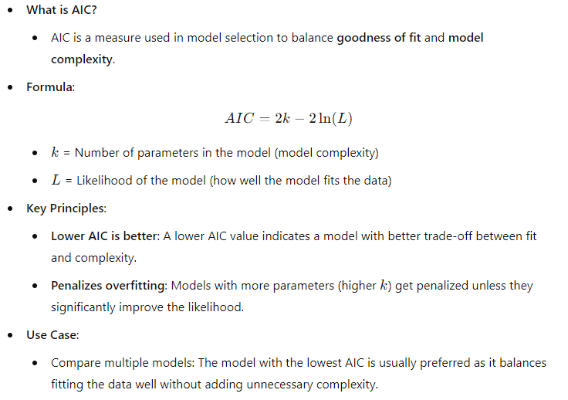
Akaike Information Criterion (AIC)

Slide 38
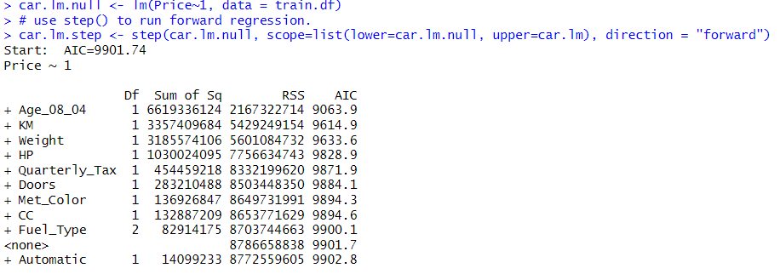
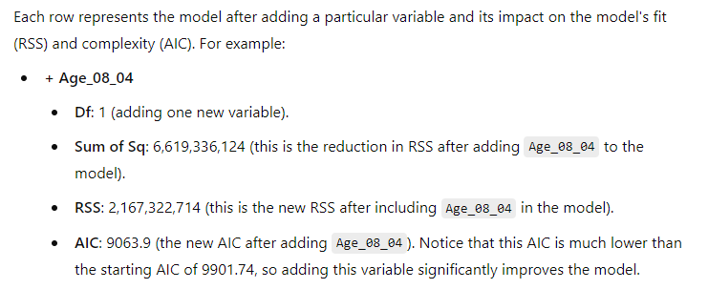
Notes:
What is a Null Model?:
A null model is a baseline model that only includes an intercept and no predictors.
The intercept represents the mean of the dependent variable, in this case, the average value of Price.
The null model assumes that all predictions are the same, and the best estimate of Price is simply its overall mean, regardless of the values of any other variables.

Slide 39
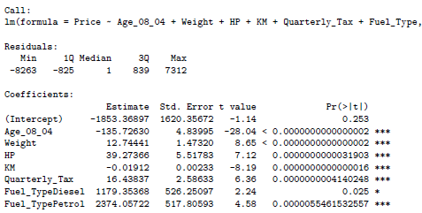
Forward Selection Yields 7 predictor model
© Galit Shmueli and Peter Bruce 2017

Slide 40
Backward Elimination
Start with all predictors
Successively eliminate least useful predictors one by one
Stop when all remaining predictors have statistically significant contribution
car.lm.step <- step(car.lm, direction = "backward")
summary(car.lm.step)
# Which variables were dropped?
(no need to specify search range)
© Galit Shmueli and Peter Bruce 2017

Slide 41
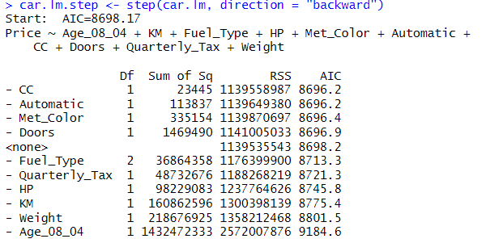
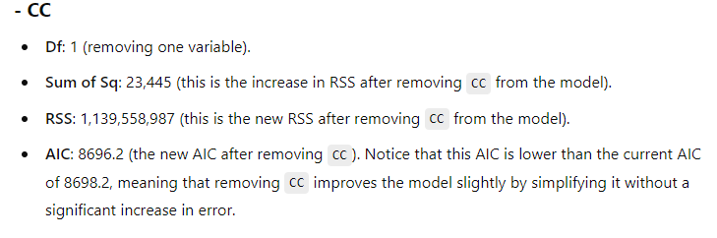

Slide 42
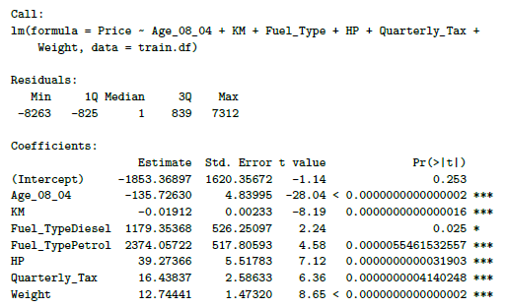
Backward Selection Yields Same 7 Predictors as Forward
© Galit Shmueli and Peter Bruce 2017

Slide 43
Stepwise
Like Forward Selection
Except at each step, also consider dropping non-significant predictors
car.lm.step <- step(car.lm, direction = "both")
summary(car.lm.step)
# Which variables were added/dropped?
© Galit Shmueli and Peter Bruce 2017
Notes:
When you set direction = "both" in the step() function in R, the algorithm performs "bidirectional" or "two-way" stepwise regression. This means that at each step, the algorithm considers both adding a new predictor to the model and removing an existing predictor from the model. The objective is to find the model that minimizes the Akaike Information Criterion (AIC) or another specified criterion.
How It Works:
Starting Model: The algorithm starts with an initial model you provide. This could be a null model with no predictors or a full model with all possible predictors.
Adding and Removing: At each step, the algorithm evaluates the effect on the AIC (or other criteria) of adding each predictor not in the model and removing each predictor already in the model.
Best Step: Among all possible additions and removals, the algorithm chooses the one that most improves the AIC.
Stopping Criterion: The algorithm stops when no addition or removal improves the AIC.
In R, the lm() function automatically converts factor variables to dummy variables when fitting a linear model. If a predictor variable in the formula is a factor with k levels, lm() will create k−1 dummy varia
The step() function does not perform the conversion itself but relies on the modeling function that generated the initial model (often lm()) to handle the factor variables. If you start with a model object created by lm(), then any factor variables will already be represented by dummy variables, and step() will carry this representation through each step of the model selection process.bles to represent it.

Slide 44
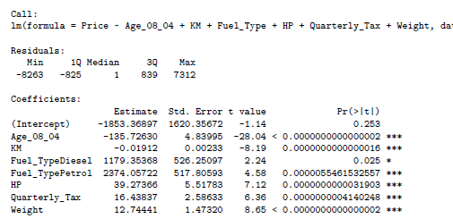
Stepwise Also Yields Same 7 Predictors
© Galit Shmueli and Peter Bruce 2017

Slide 45
Comparing Methods See Tables 6.5 – 6.8
using lm
LEAPS
Variable | Forward | Backward | Both | Exhaustive*
Age_08_04 | ✔ | ✔ | ✔ | ✔
KM | ✔ | ✔ | ✔ | ✔
HP | ✔ | ✔ | ✔ | ✔
Met_Color
Automatic
CC
Doors
Quarterly_Tax | ✔ | ✔ | ✔ | ✔
Weight | ✔ | ✔ | ✔ | ✔
Fuel_TypeCNG |  |  |  | ✔
Fuel_TypeDiesel | ✔ | ✔ | ✔ | ✔
Fuel_TypePetrol | ✔ | ✔ | ✔
*for 7 predictors
Different, but equivalent set of dummies because they were created manually in LEAPS
© Galit Shmueli and Peter Bruce 2017

Slide 46
Reviewing all the methods, these three predictors are consistently the most important:
Variable | Forward | Backward | Both | Exhaustive*
Age_08_04 | ✔ | ✔ | ✔ | ✔
KM | ✔ | ✔ | ✔ | ✔
HP | ✔ | ✔ | ✔ | ✔
Met_Color
Automatic
CC
Doors
Quarterly_Tax | ✔ | ✔ | ✔ | ✔
Weight | ✔ | ✔ | ✔ | ✔
Fuel_TypeCNG |  |  |  | ✔
Fuel_TypeDiesel | ✔ | ✔ | ✔ | ✔
Fuel_TypePetrol | ✔ | ✔ | ✔
*for 7 predictors
© Galit Shmueli and Peter Bruce 2017

Slide 47
Summary
Linear regression models are very popular tools, not only for explanatory modeling, but also for prediction
A good predictive model has high predictive accuracy (to a useful practical level)
Predictive models are fit to training data, and predictive accuracy is evaluated on a separate validation data set
Removing redundant predictors is key to achieving predictive accuracy and robustness
Subset selection methods help find “good” candidate models. These should then be run and assessed.
© Galit Shmueli and Peter Bruce 2017

Slide 48
Appendix

Slide 49
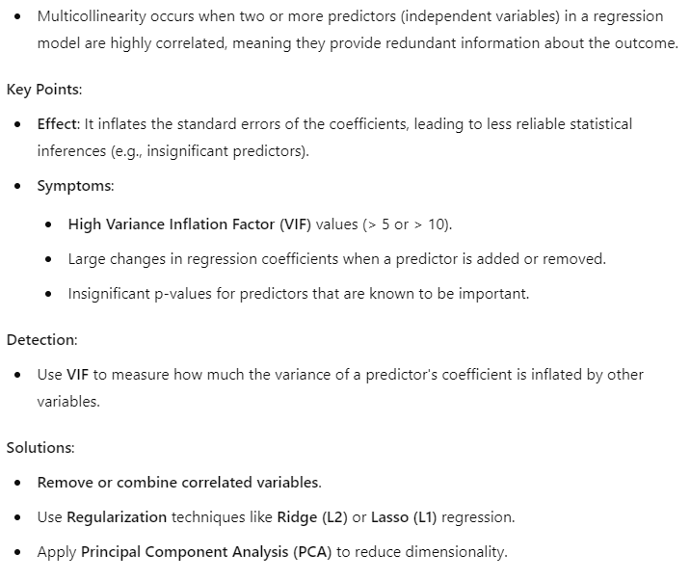
Multicollinearity in Regression Analysis
© Galit Shmueli and Peter Bruce 2017

Slide 50
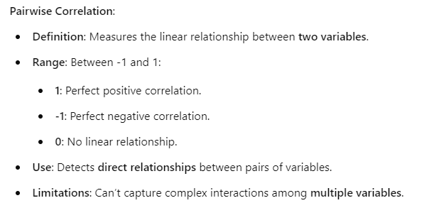
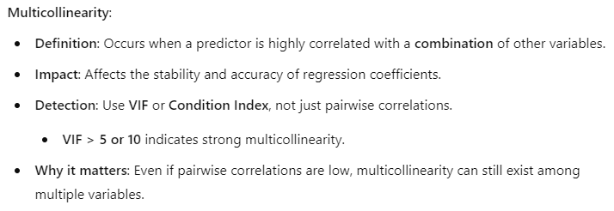
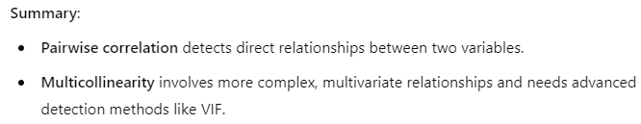
Pairwise Correlation vs. Multicollinearity
© Galit Shmueli and Peter Bruce 2017

Slide 51
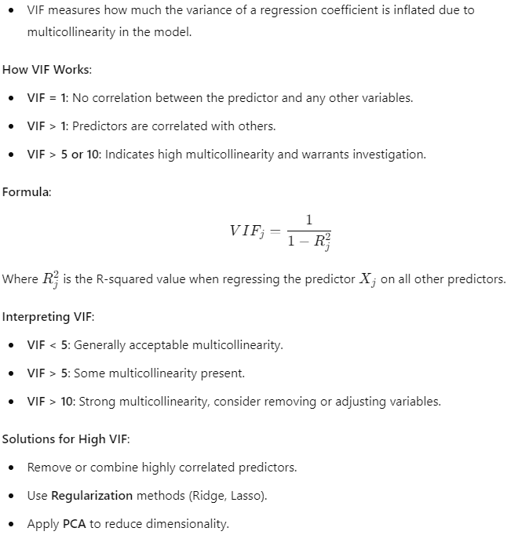
Variance Inflation Factor (VIF)
© Galit Shmueli and Peter Bruce 2017

Slide 52
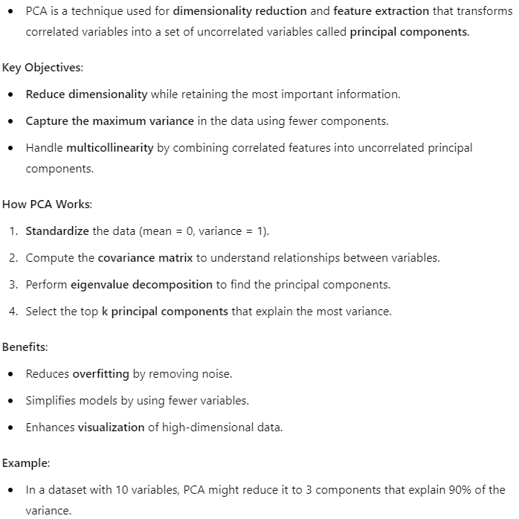
Principal Component Analysis (PCA)
© Galit Shmueli and Peter Bruce 2017

Slide 53
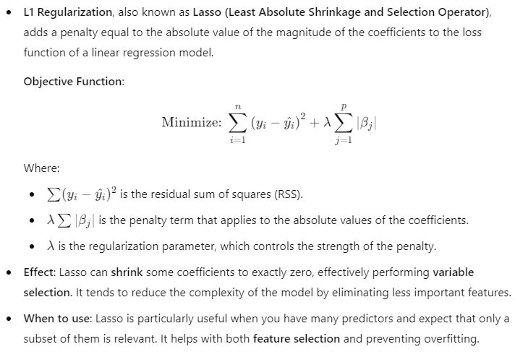
L1 Regularization (Lasso Regression)
© Galit Shmueli and Peter Bruce 2017
Notes:
Multiple Linear Regression (MLR) models fit the data by minimizing the residual sum of squares (RSS) without any penalty on the size of the coefficients. This can lead to overfitting, especially when the number of predictors is large or when predictors are highly correlated (multicollinearity).
Regularization methods like Lasso, Ridge, and Elastic Net improve upon standard MLR by adding penalty terms that constrain the size of the coefficients. This helps reduce overfitting and improves the generalization of the model to new, unseen data.

Slide 54
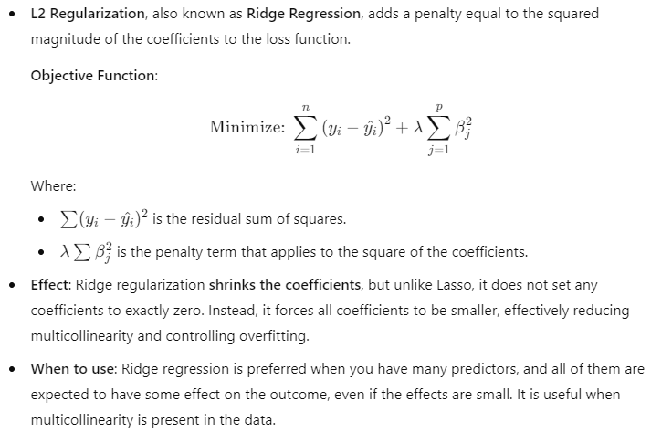
L2 Regularization (Ridge Regression)
© Galit Shmueli and Peter Bruce 2017

Slide 55
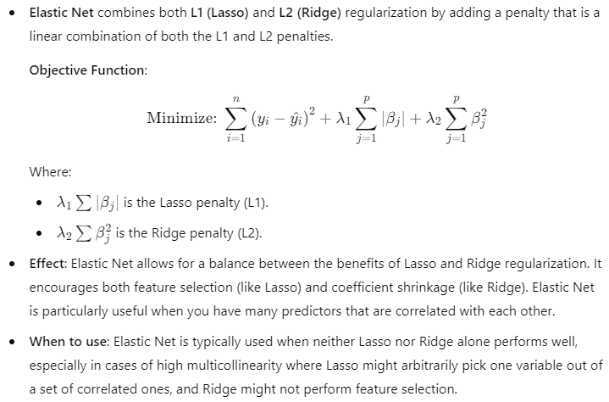
Elastic Net Regularization
© Galit Shmueli and Peter Bruce 2017

Slide 56
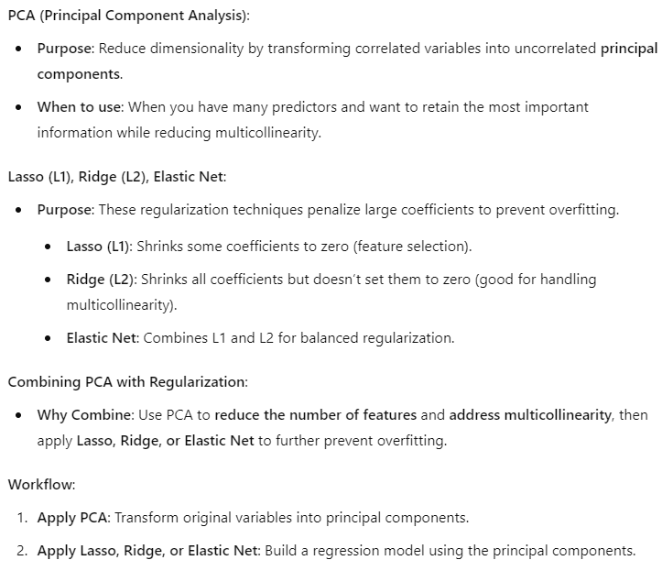
Using PCA with Lasso, Ridge and Elastic Net
© Galit Shmueli and Peter Bruce 2017

Slide 57
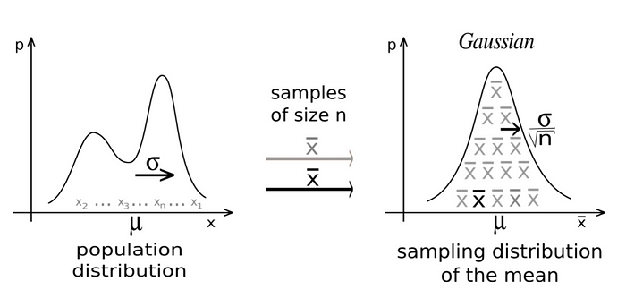
Central Limit Theorem (CLT)
Distribution of the mean of a large number of independent, identically distributed (i.i.d.) random variables approaches a normal distribution, regardless of the original distribution of the variables, provided that the samples size is sufficiently large.

